Slide 1
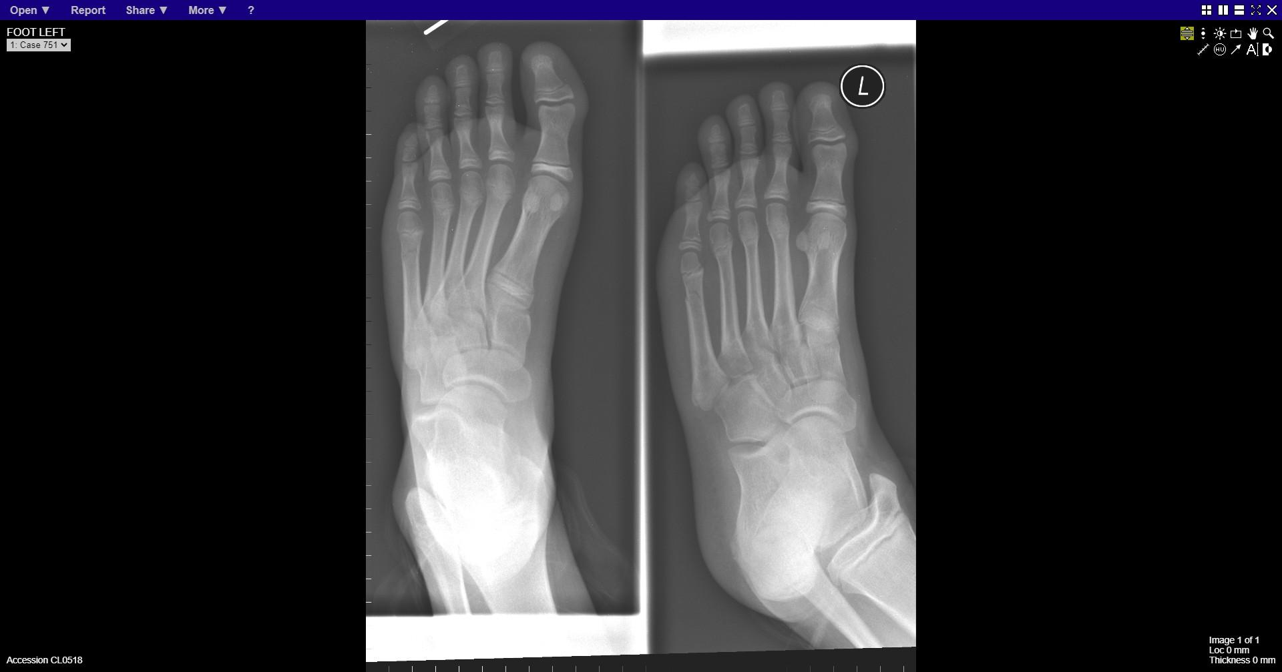
Notes:
Fracture neck of 5th metatarsal

Slide 2
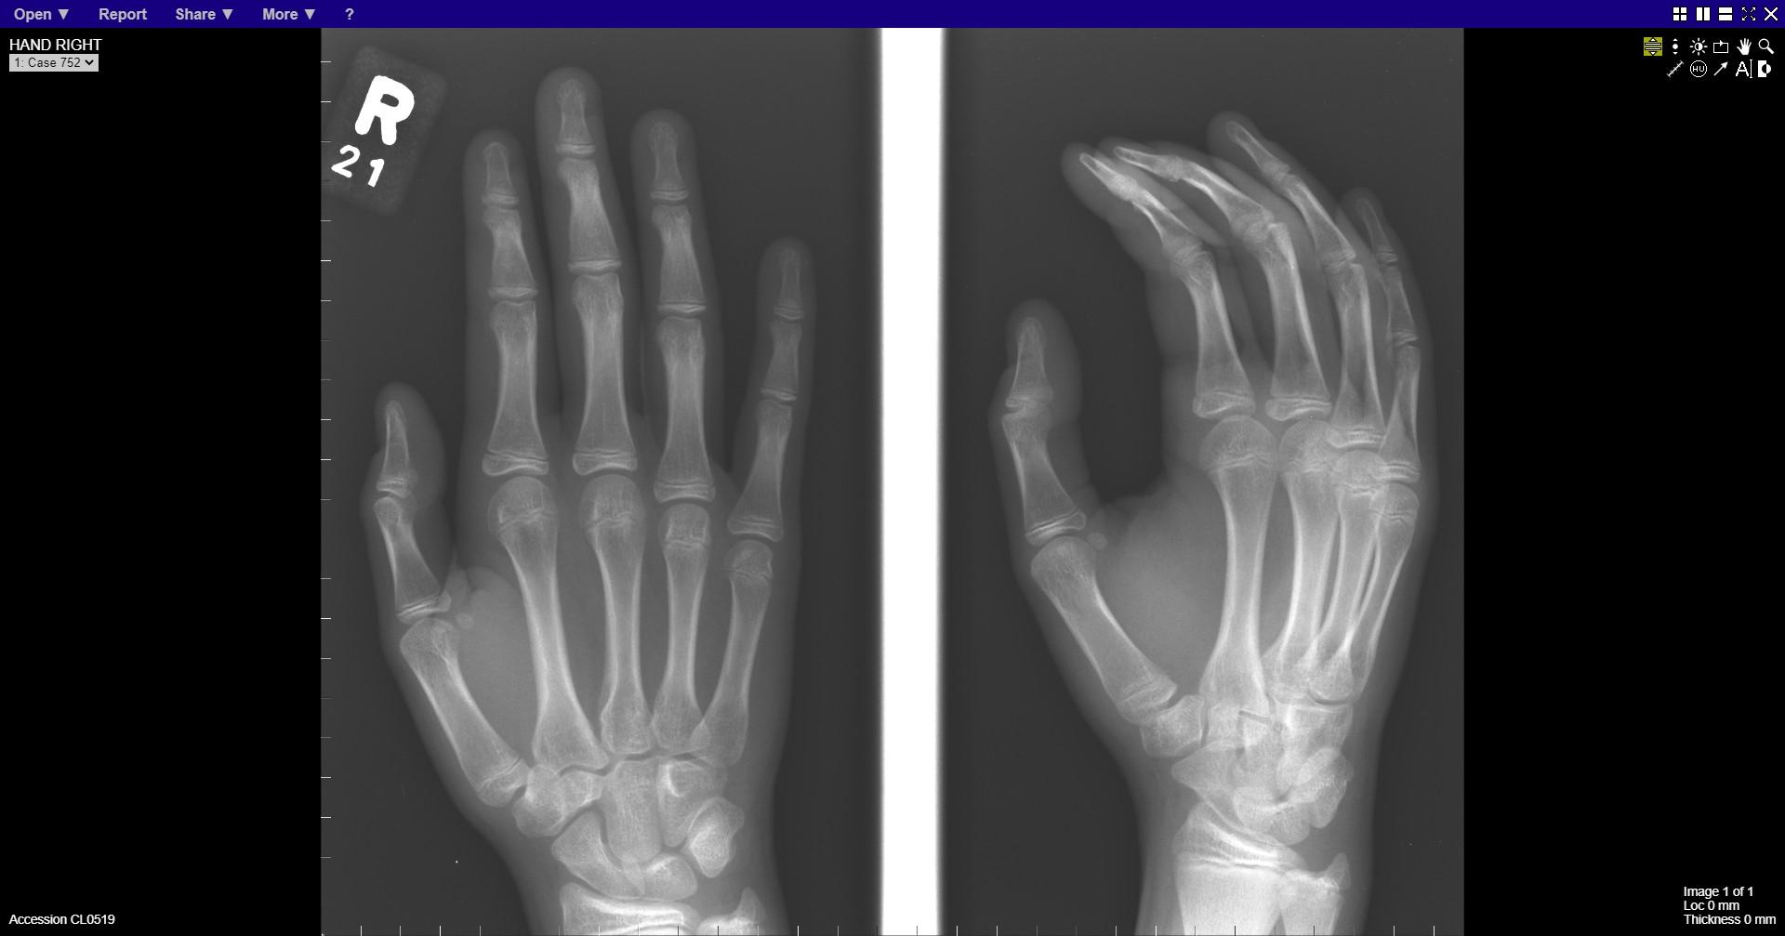
Notes:
normal

Slide 3
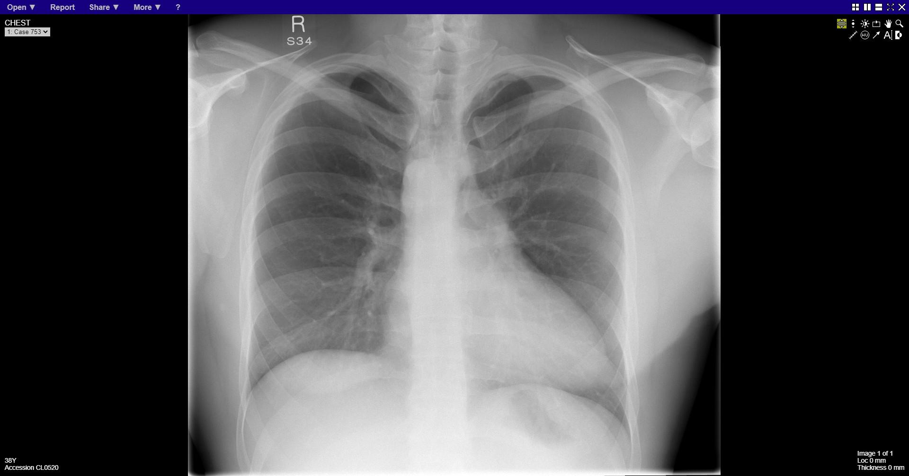
Notes:
Right aortic arch

Slide 4
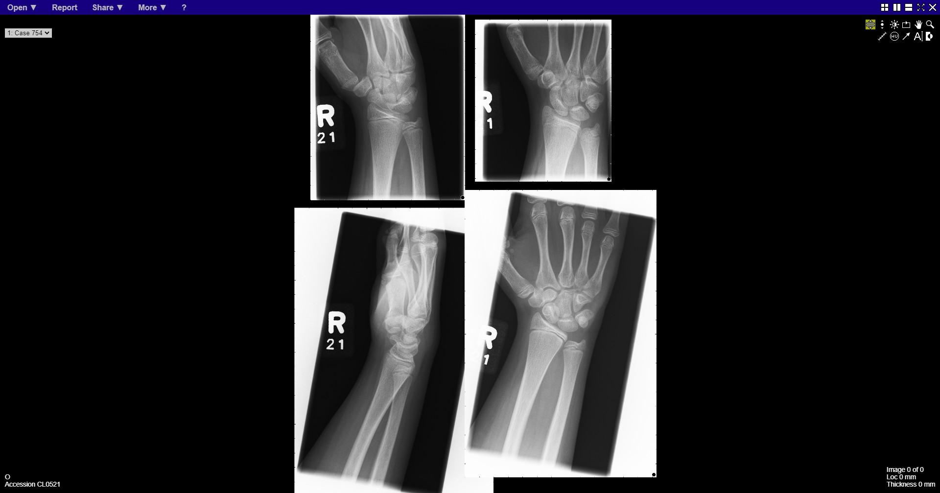
Notes:
normal

Slide 5
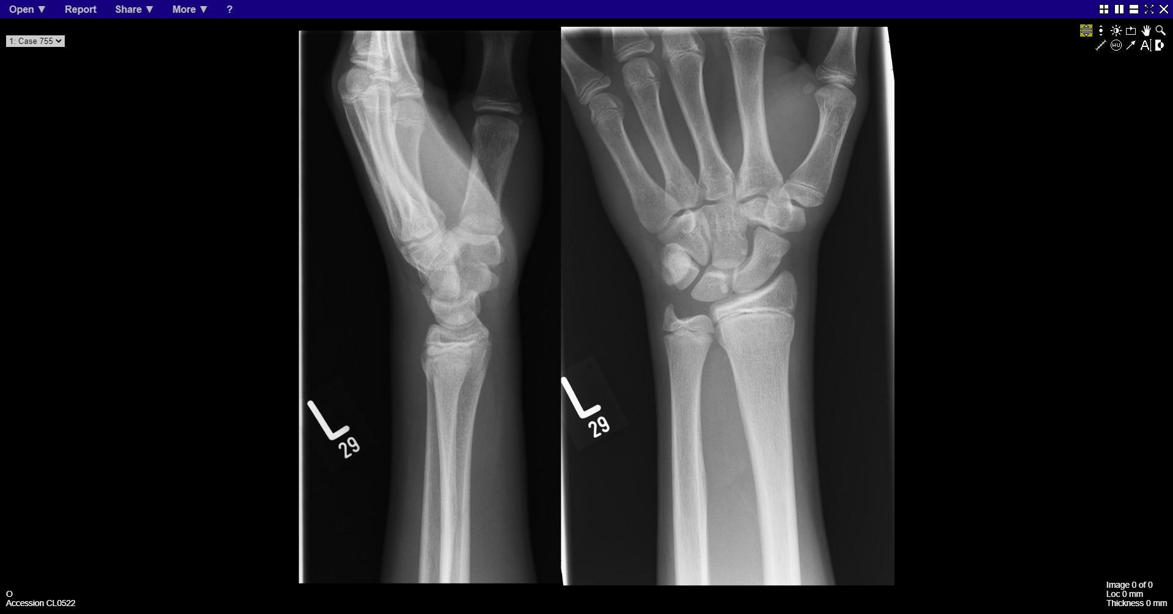
Notes:
Fracture distal radius

Slide 6
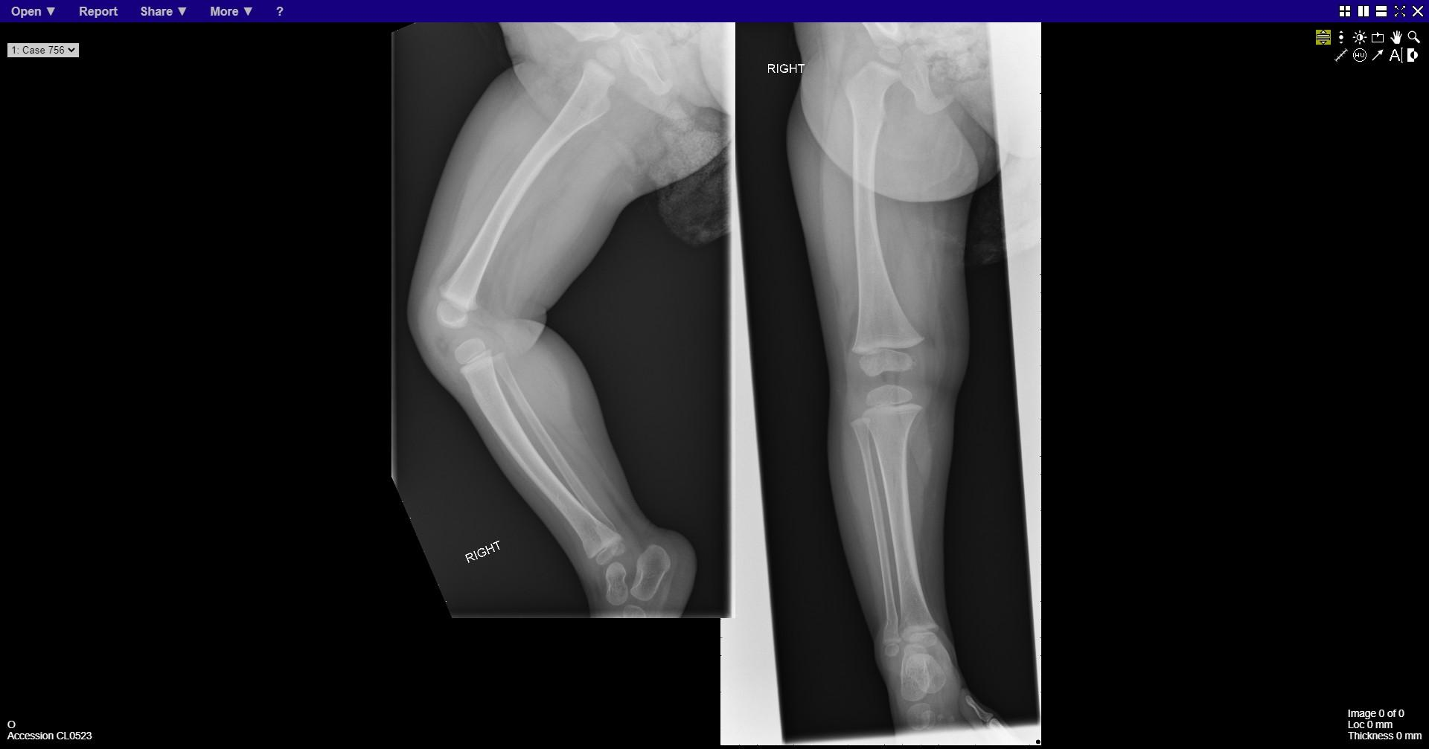
Notes:
Fracture distal tibia and fibula

Slide 7
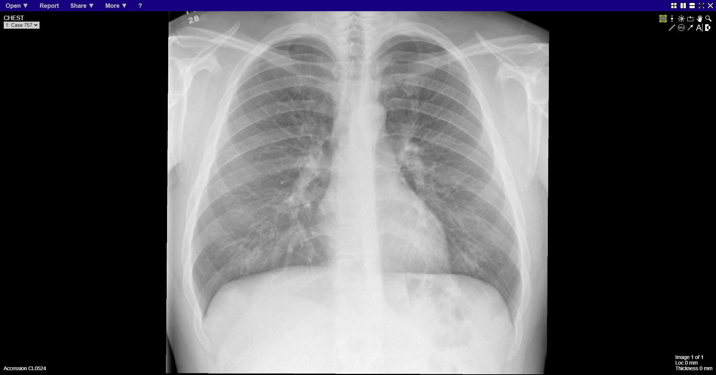
Notes:
normal

Slide 8
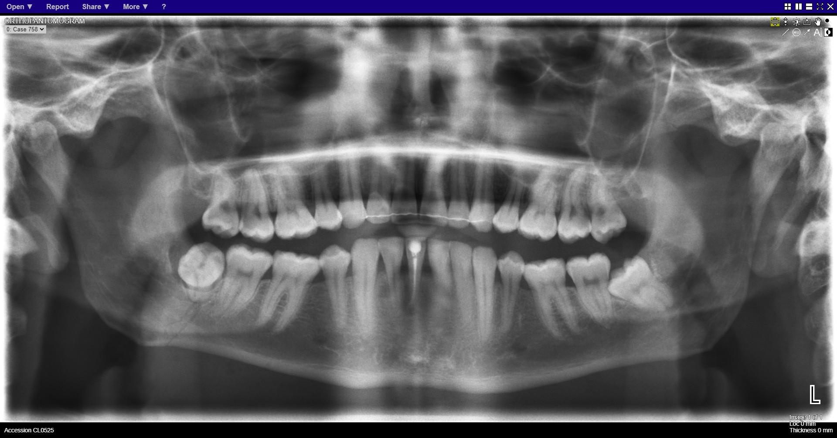
Notes:
Fracture right body of mandible

Slide 9
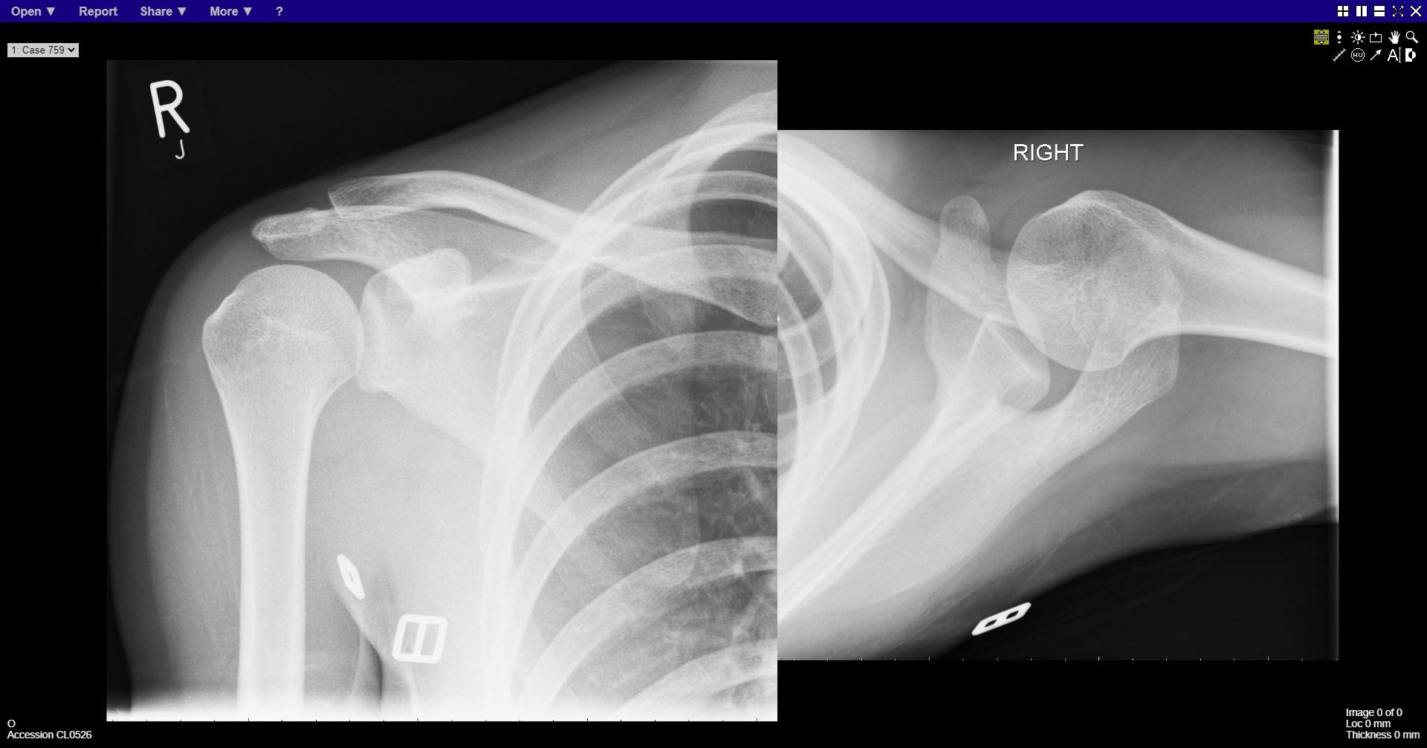
Notes:
normal

Slide 10
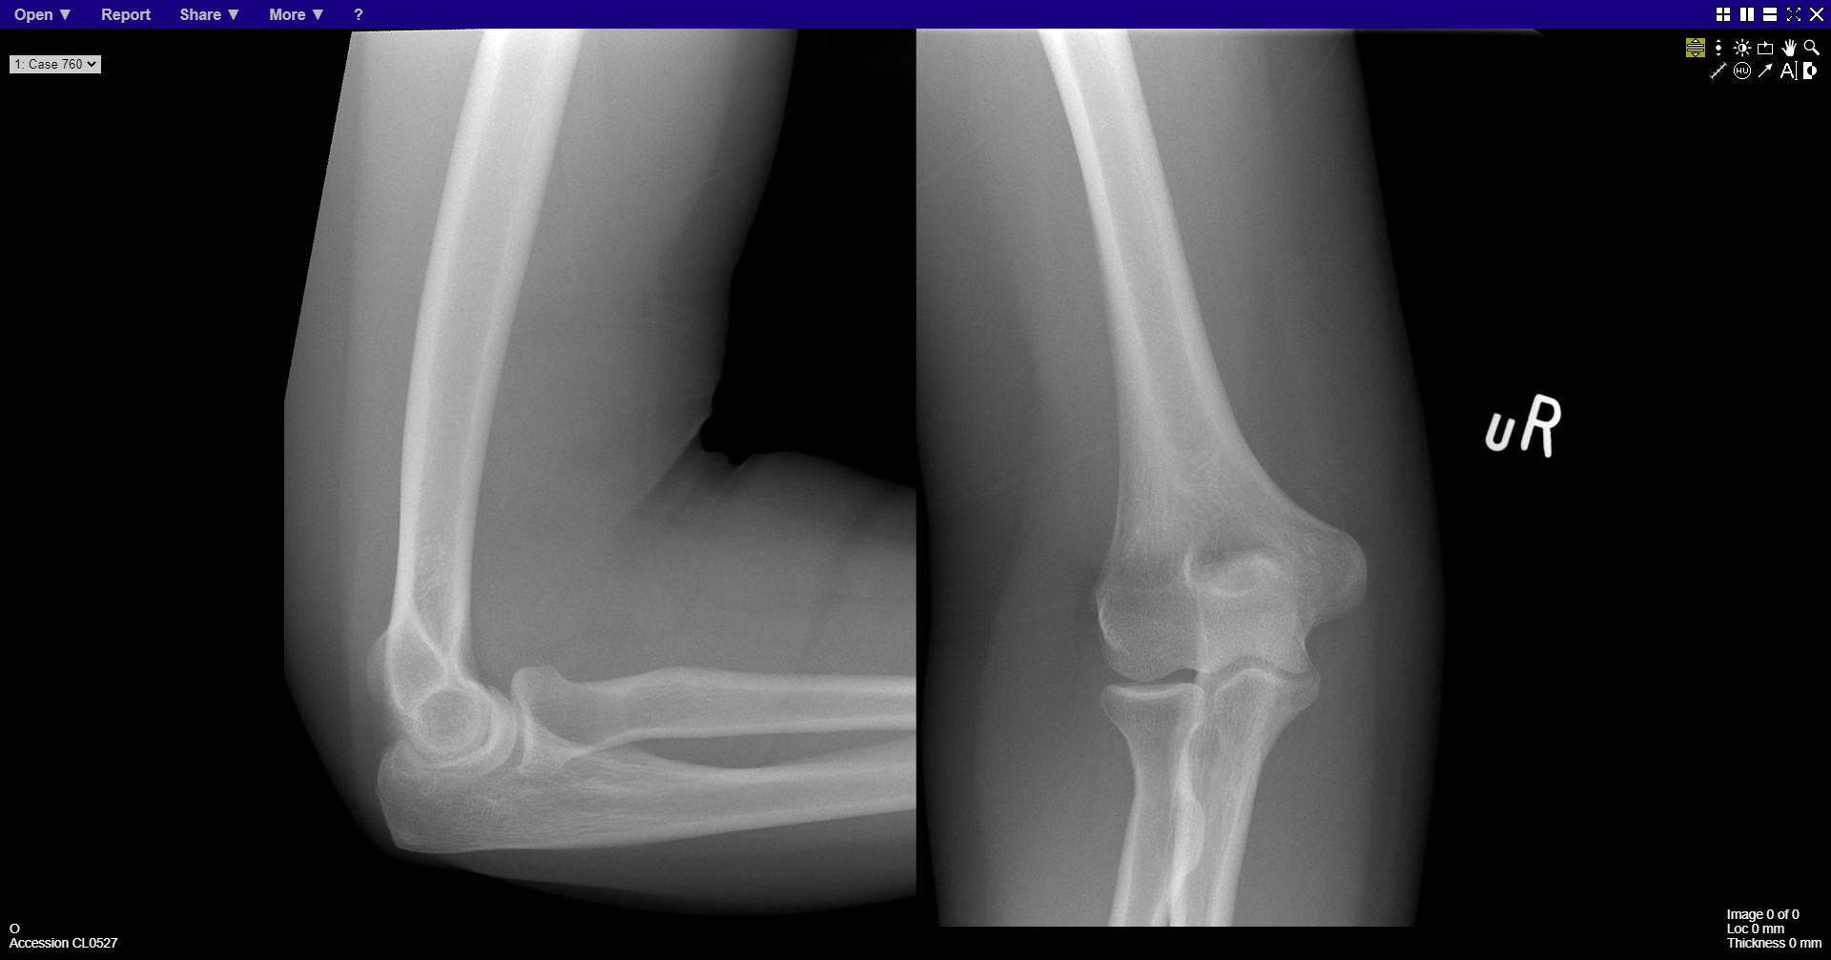
Notes:
normal

Slide 11
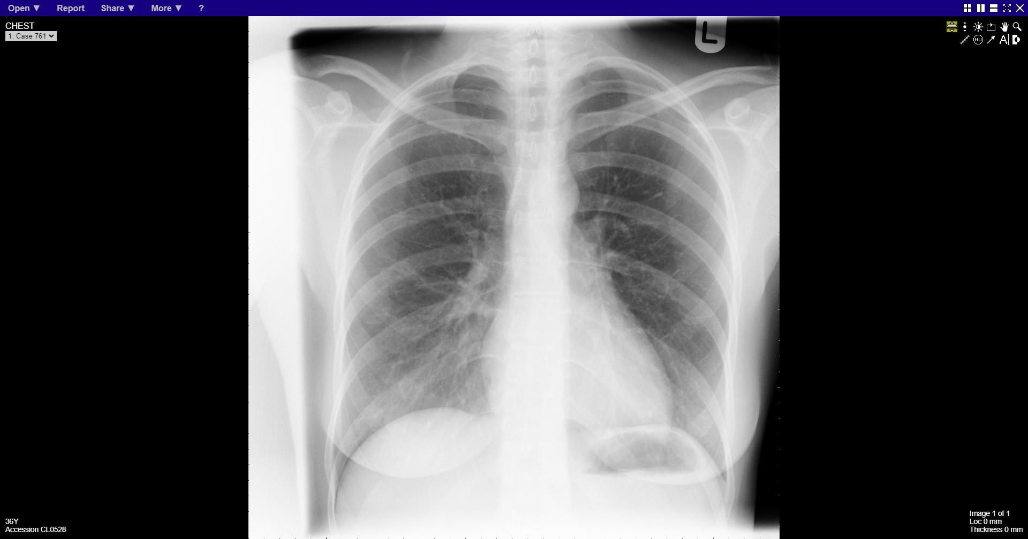
Notes:
Right apical pneumothorax

Slide 12
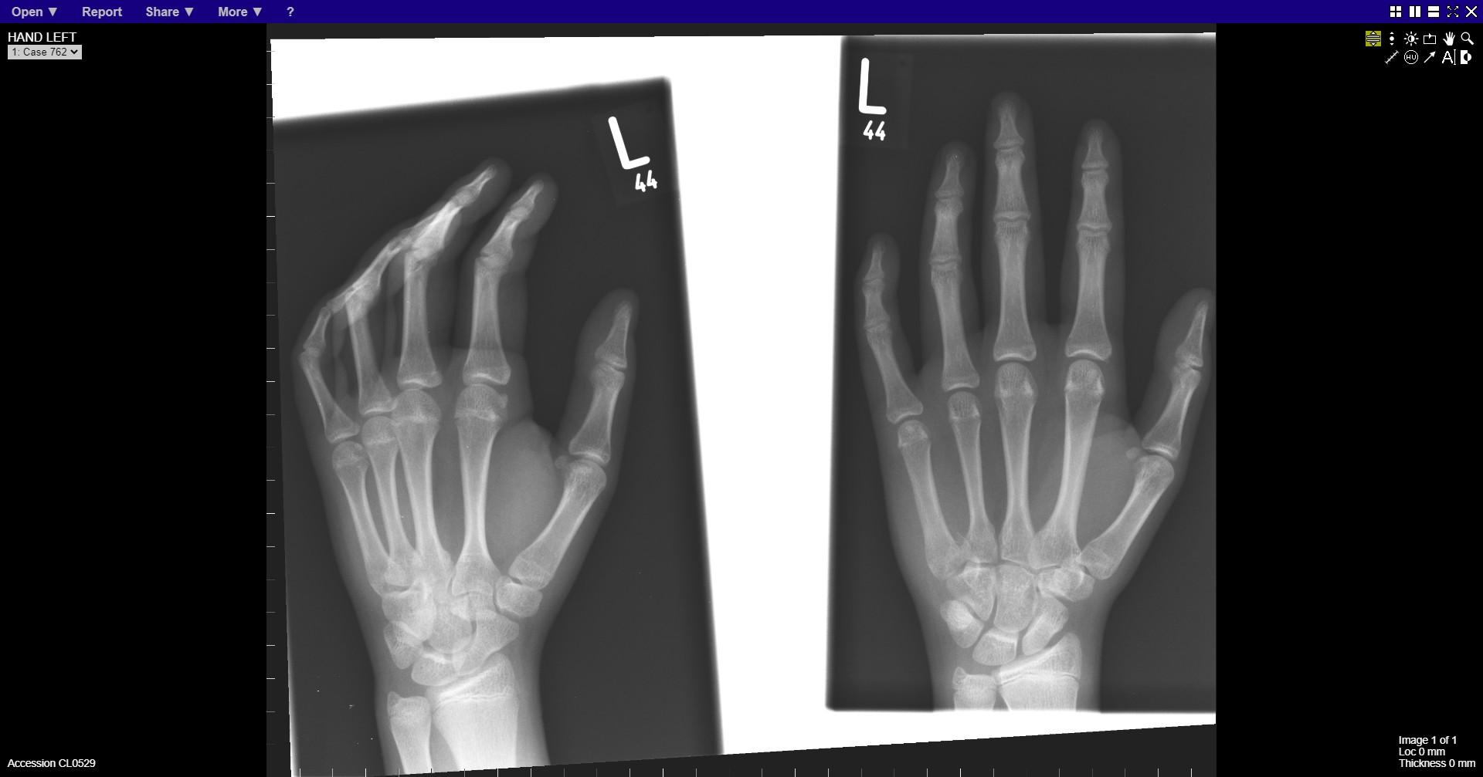
Notes:
Fracture at base of 5th metacarpal

Slide 13
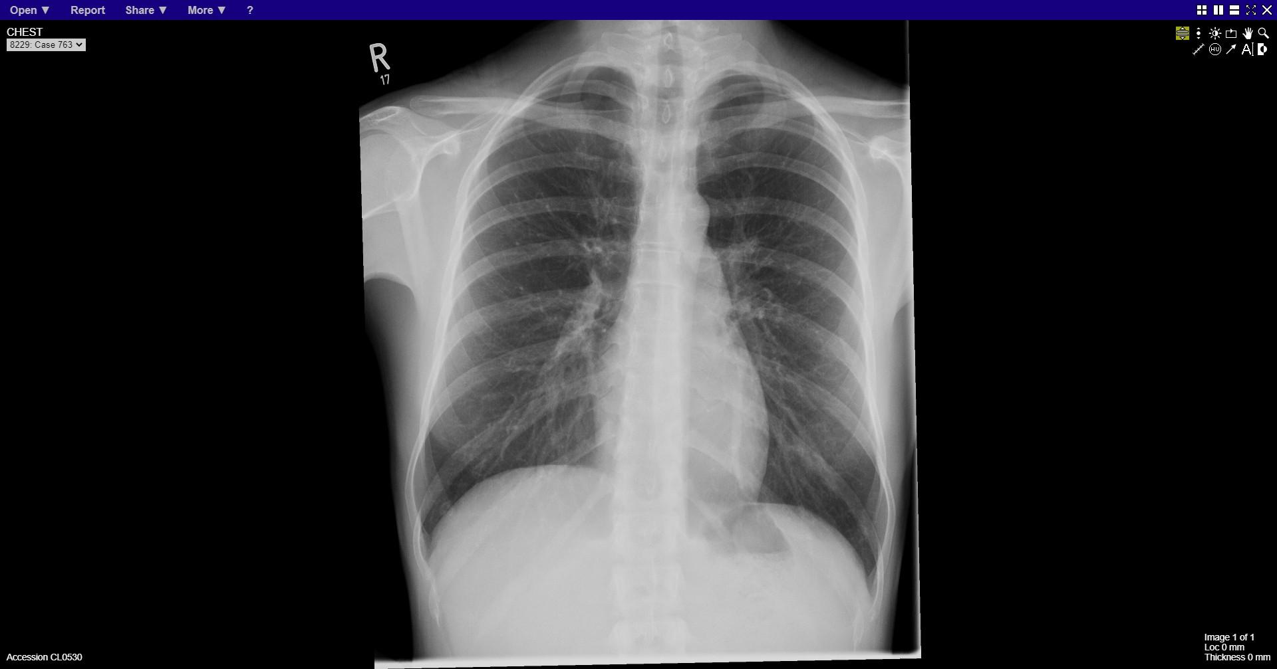
Notes:
normal

Slide 14
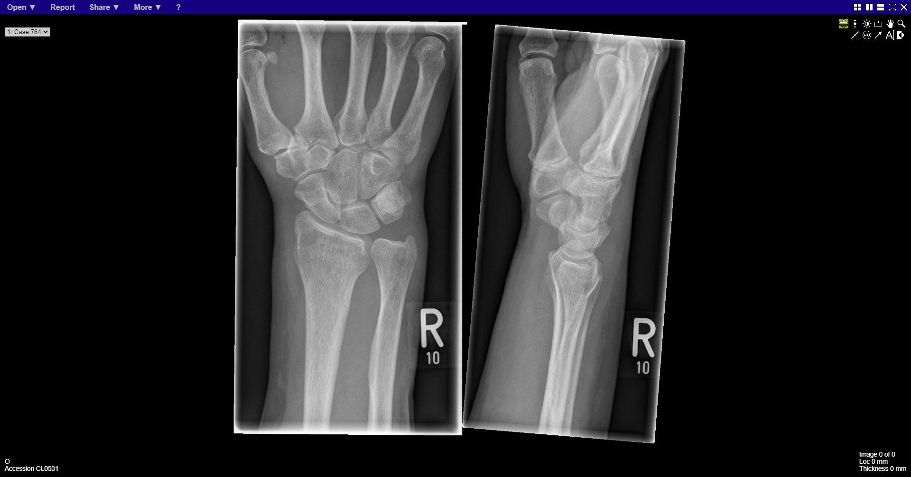
Notes:
Distal radius fracture

Slide 15
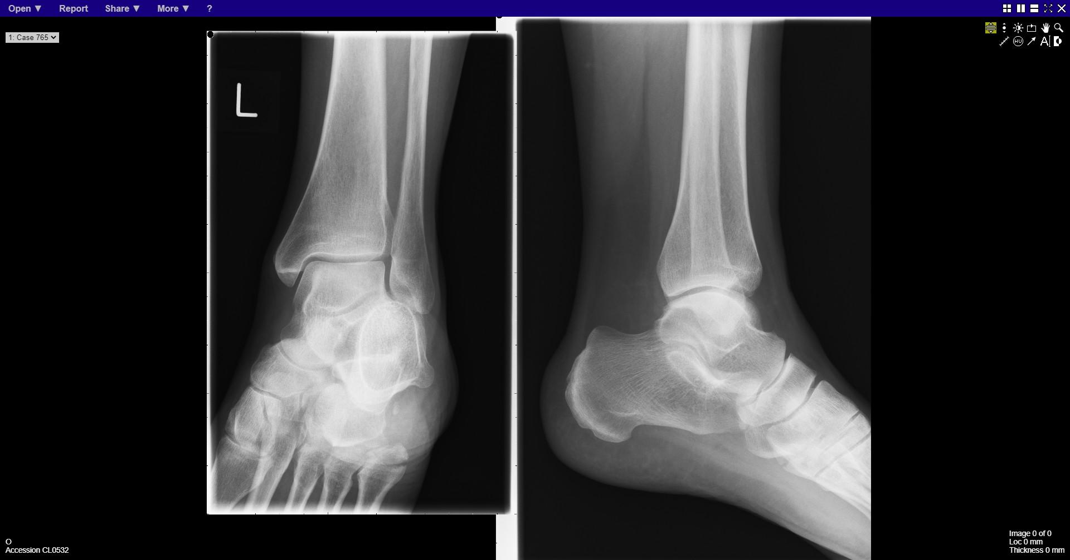
Notes:
Fracture base of 5th metatarsal

Slide 16
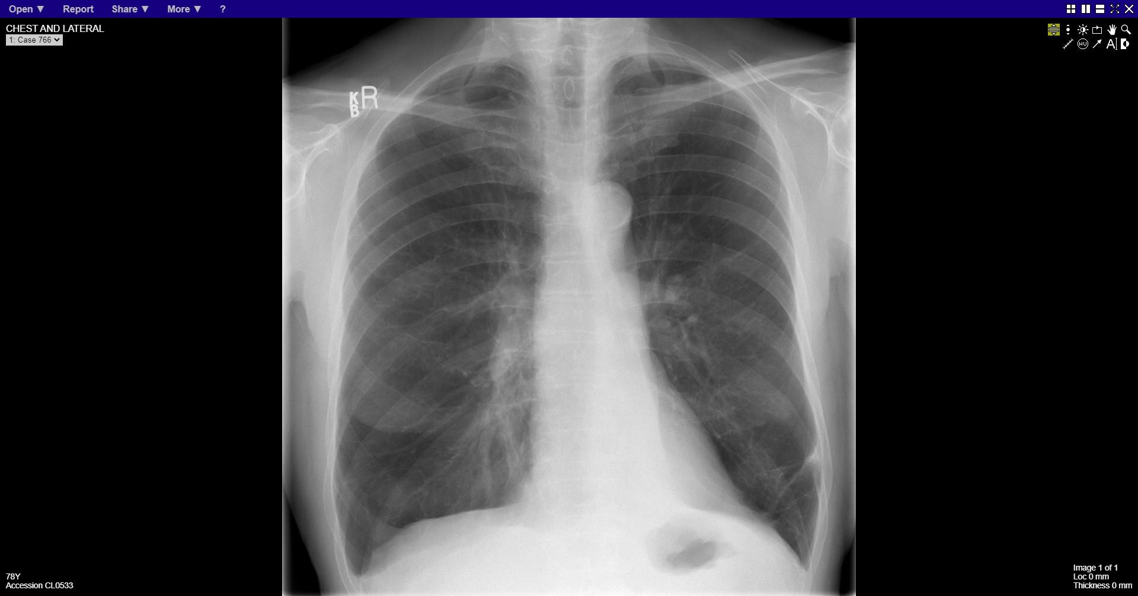
Notes:
Left lower lobe collapse

Slide 17
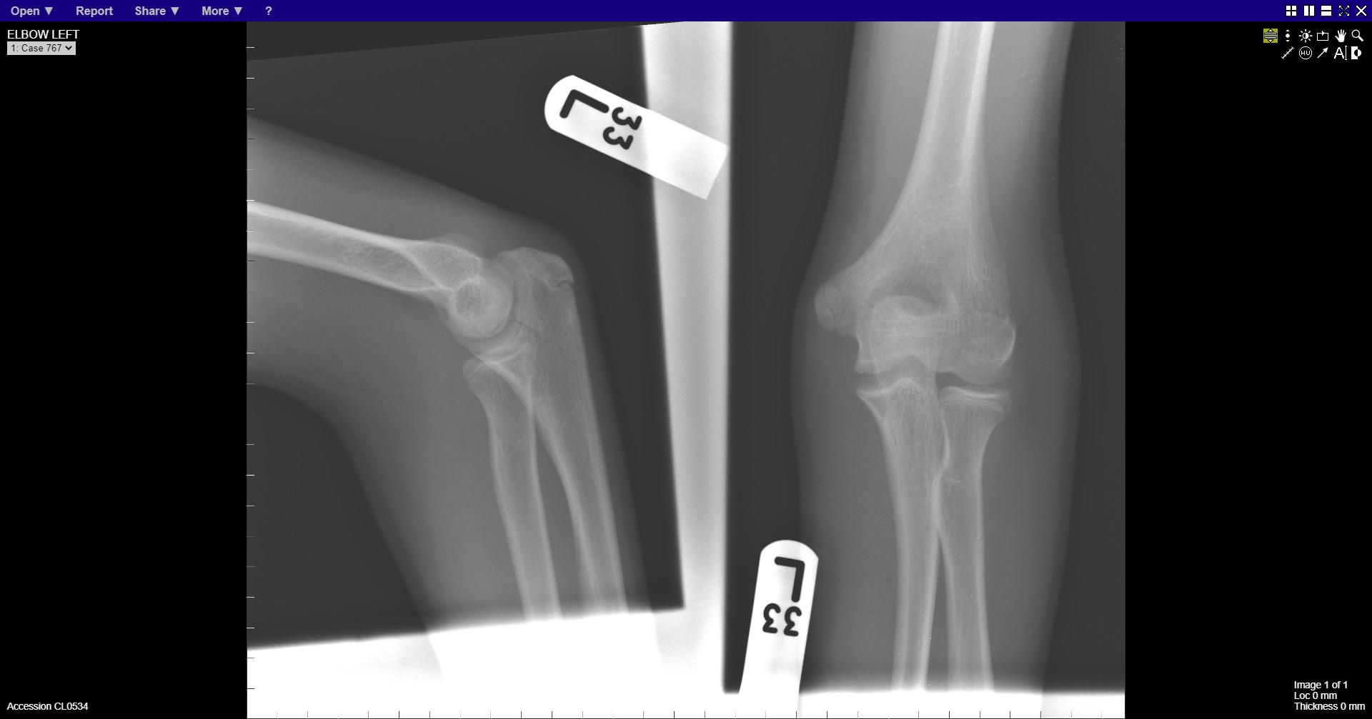
Notes:
Proximal ulna fracture

Slide 18
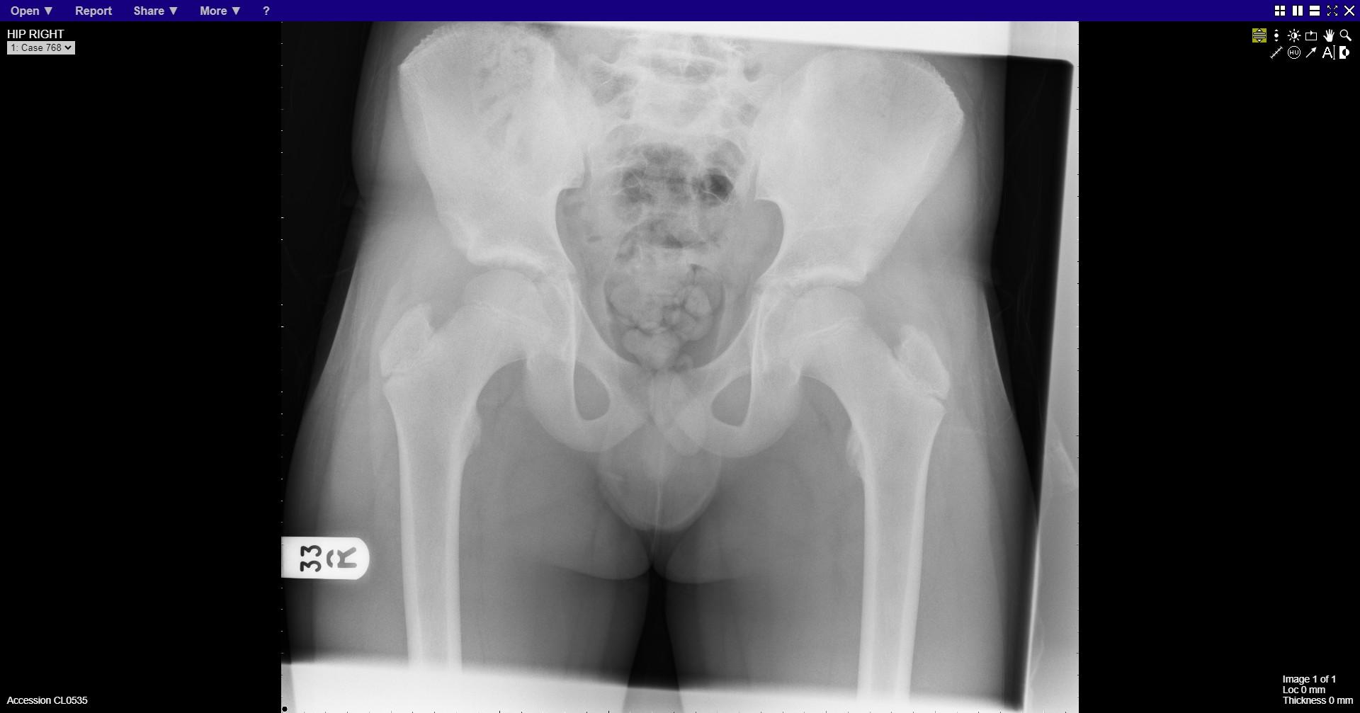
Notes:
Normal

Slide 19
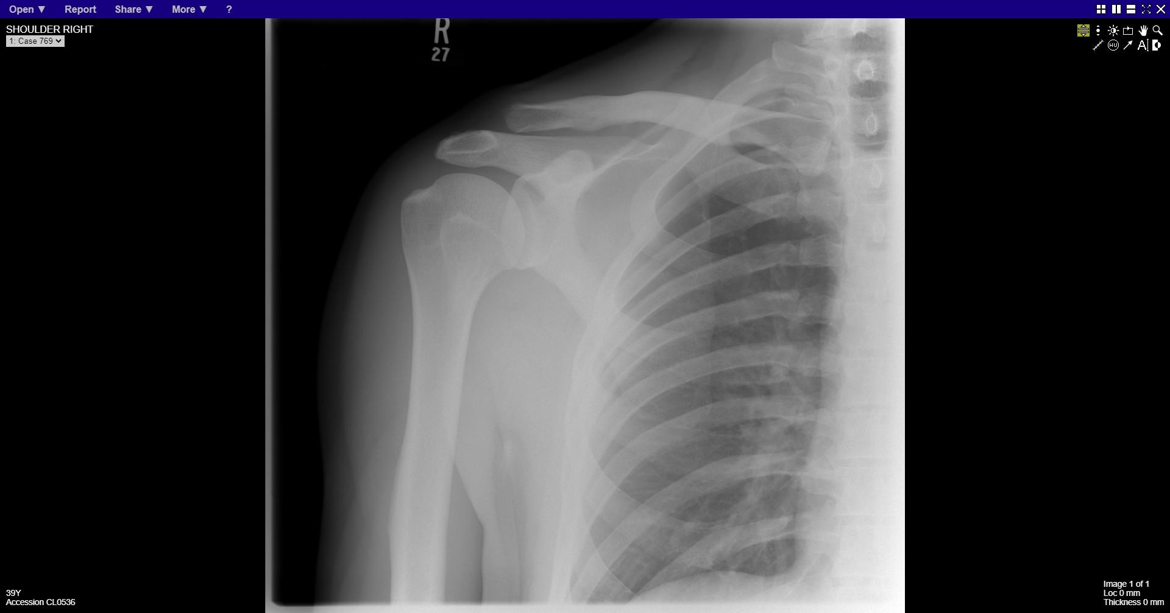
Notes:
Acromioclavicular joint subluxation

Slide 20
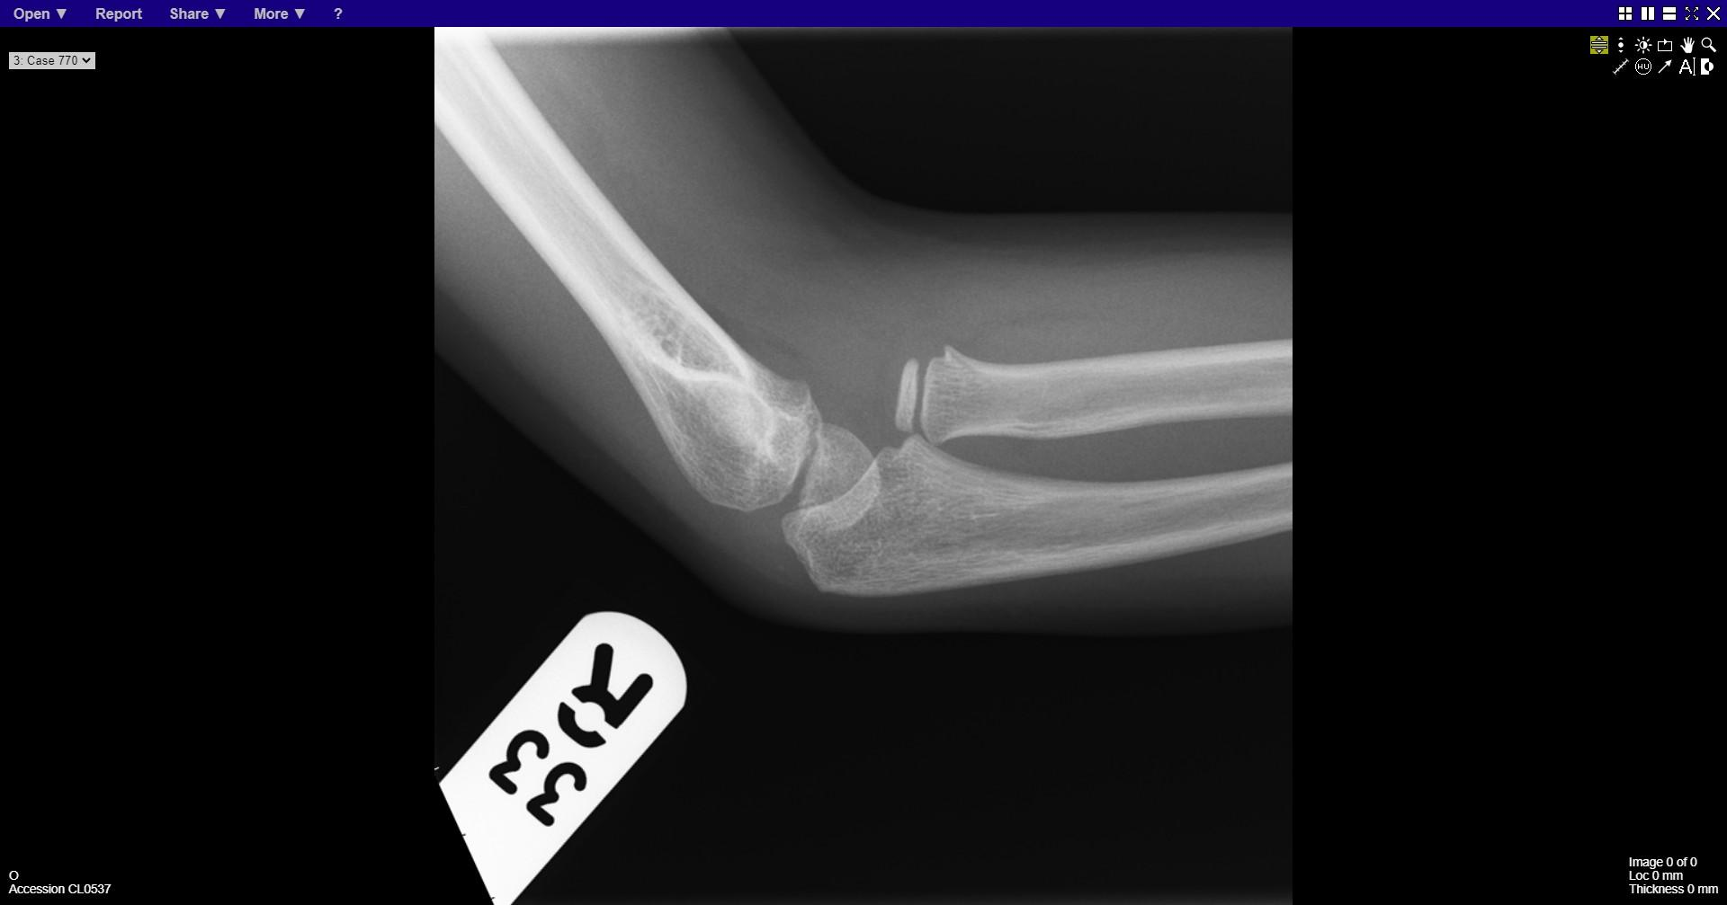
Notes:
Radial head dislocation

Slide 21
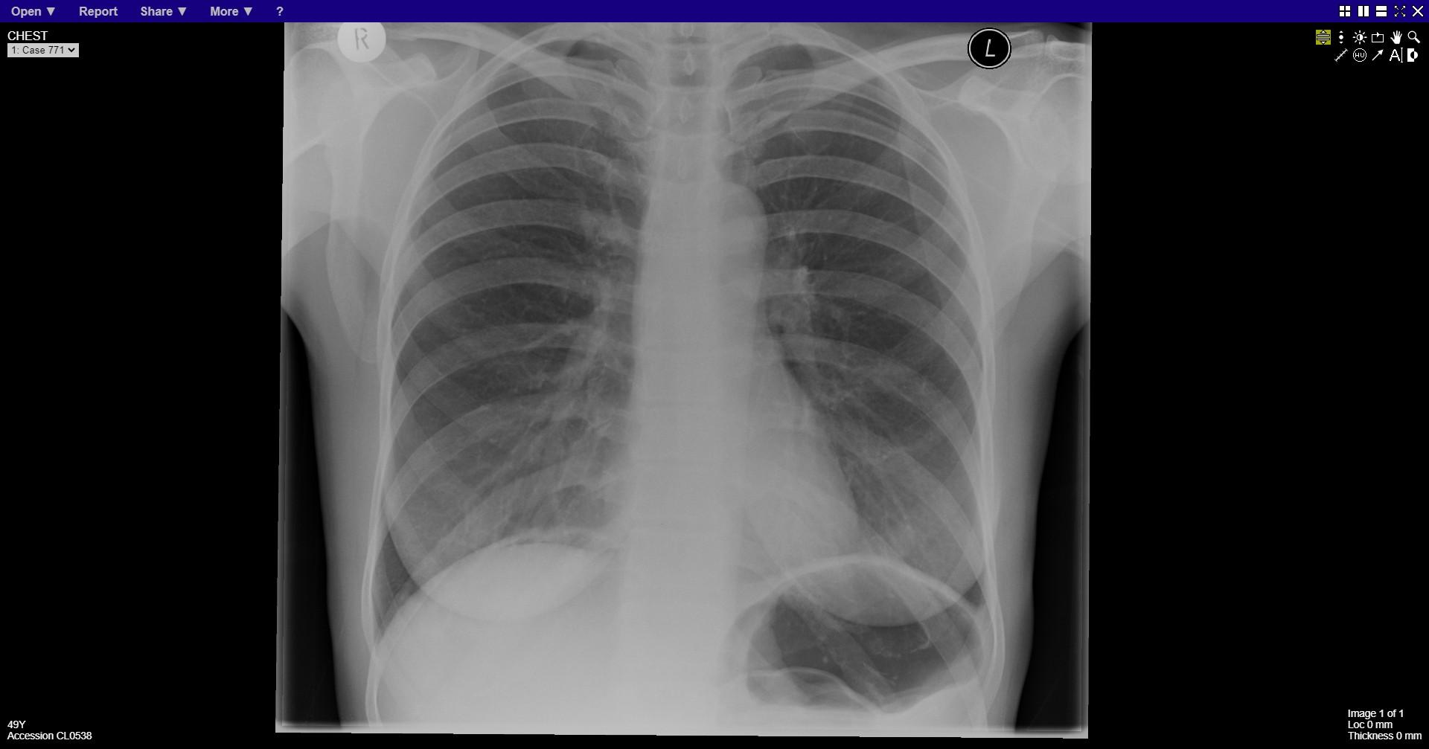
Notes:
Pneumoperitoneum

Slide 22
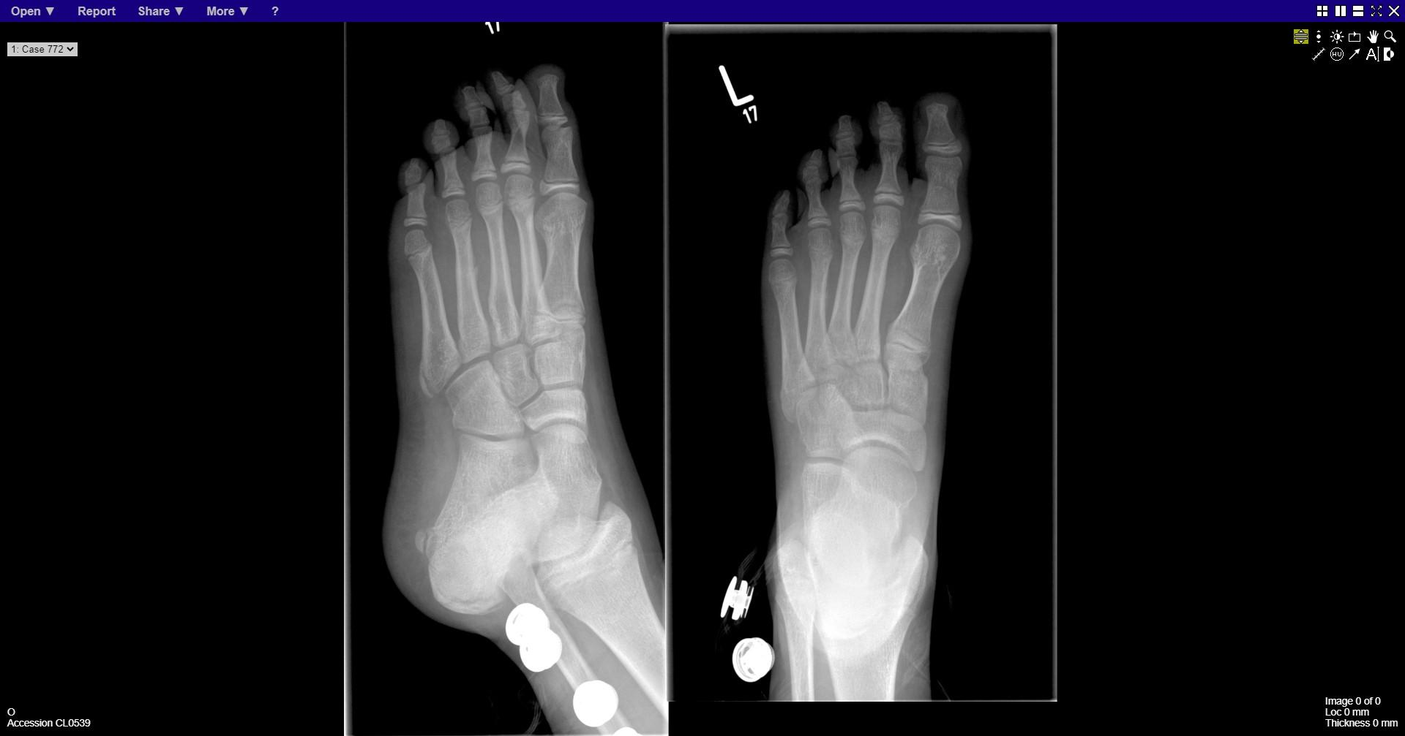
Notes:
4th metatarsal fracture

Slide 23
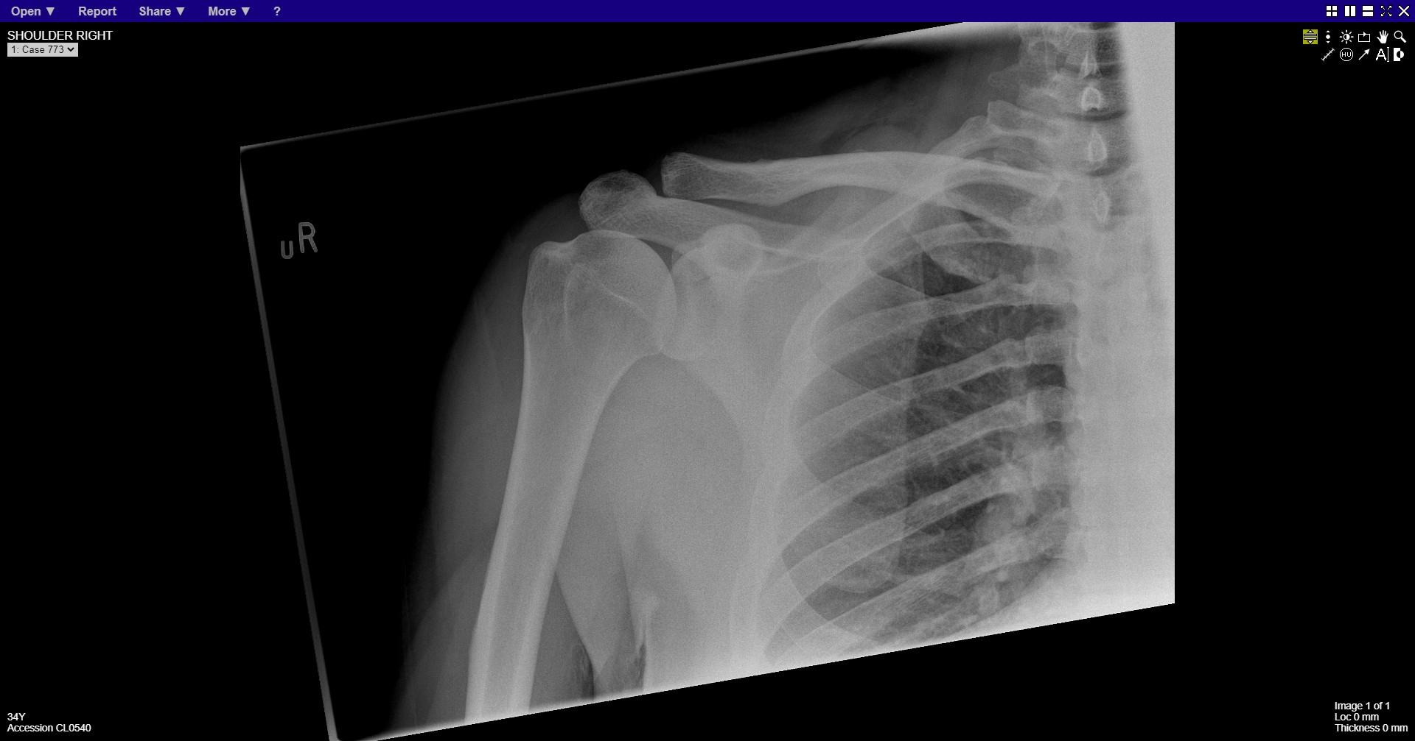
Notes:
normal

Slide 24
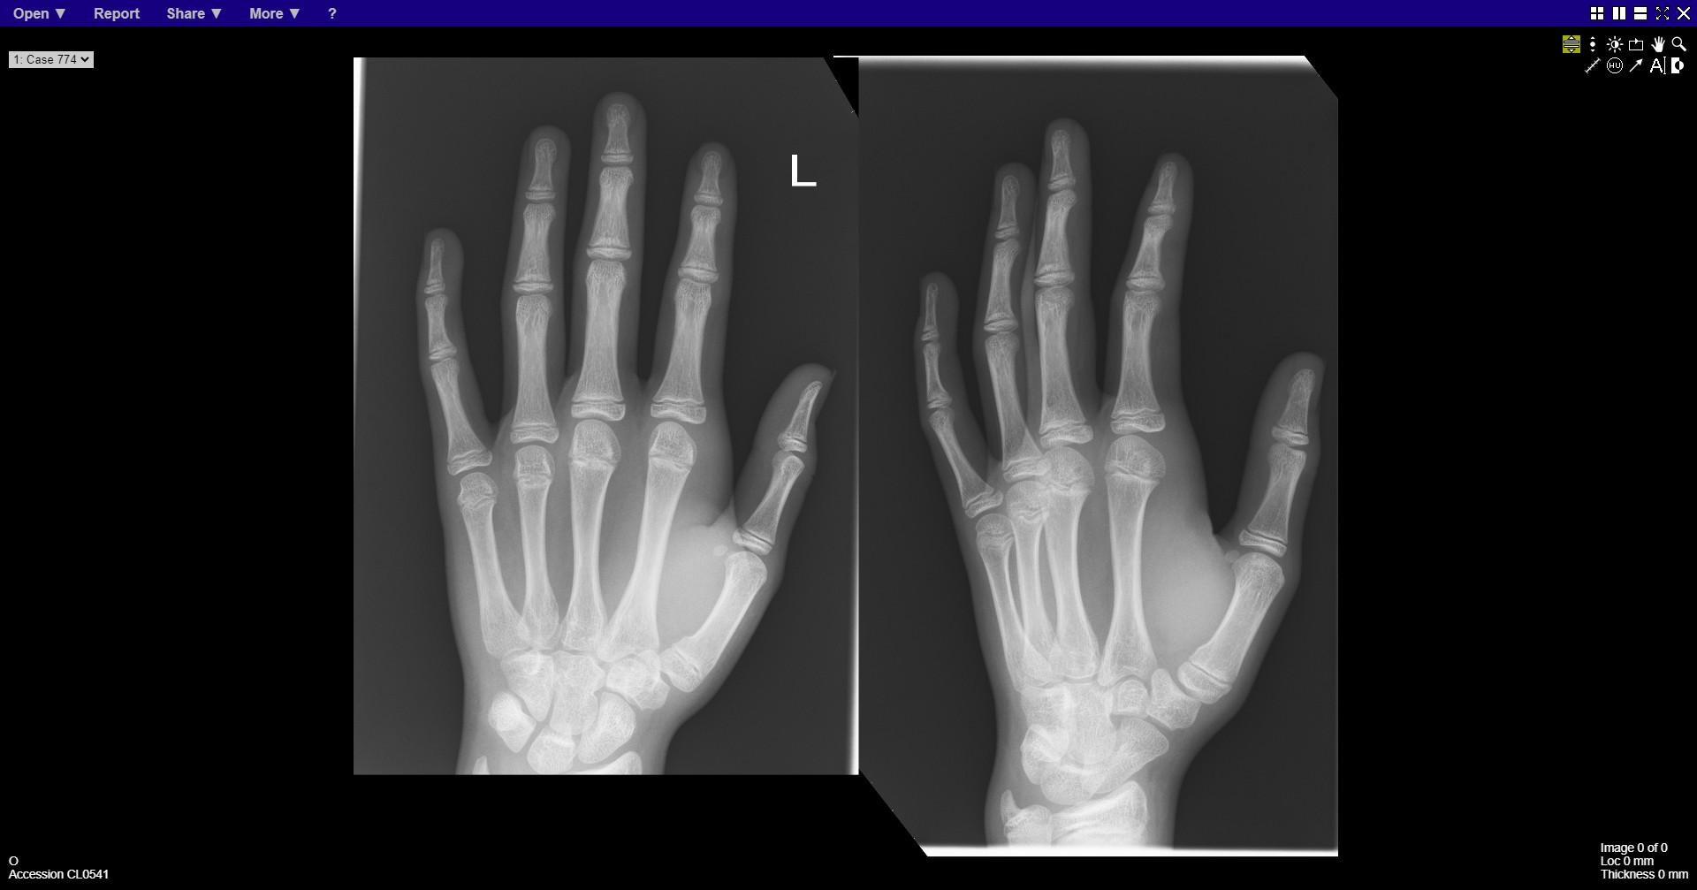
Notes:
Greenstick fracture base of 1st metacarpal

Slide 25
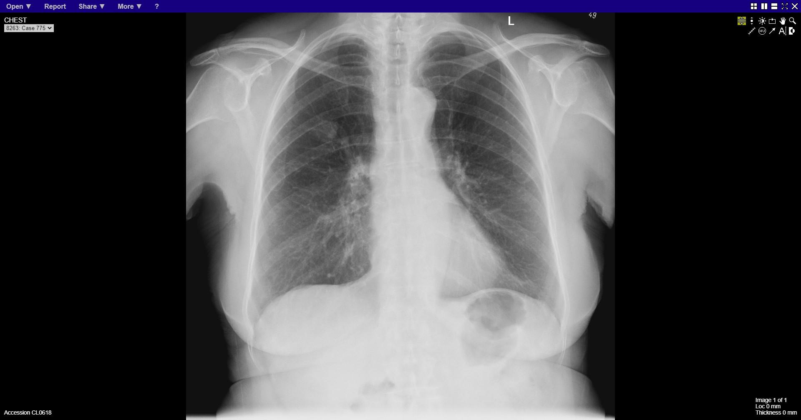
Notes:
Right upper zone opacity

Slide 26
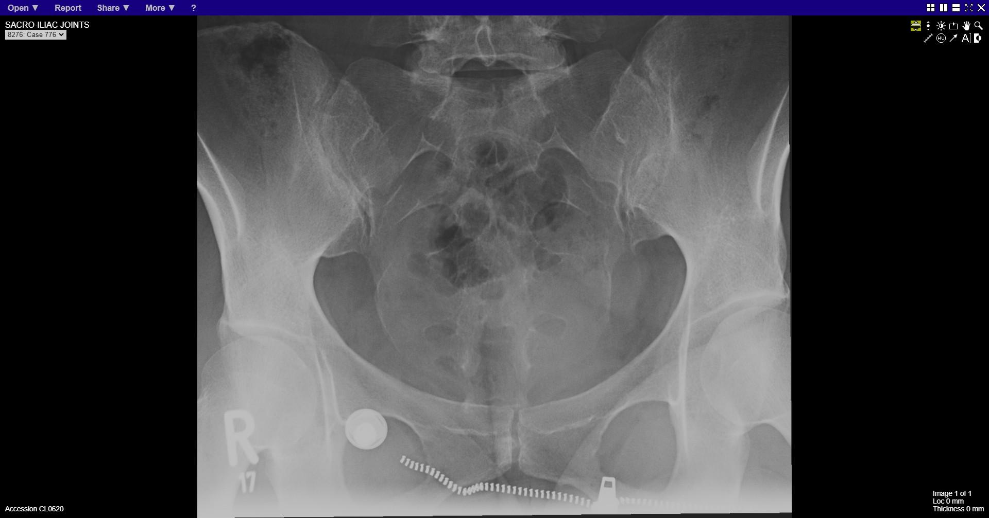
Notes:
normal

Slide 27
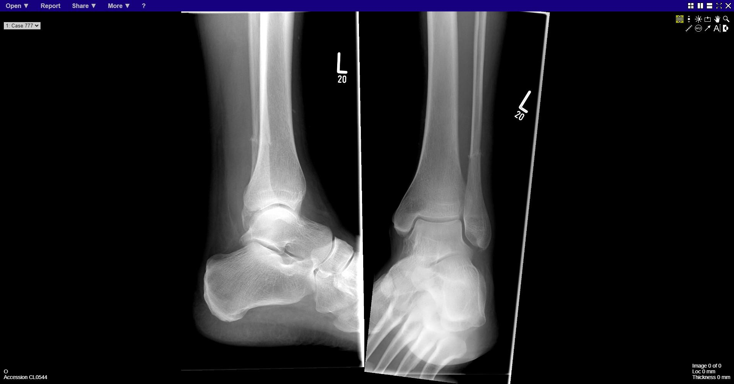
Notes:
Fracture distal fibula

Slide 28
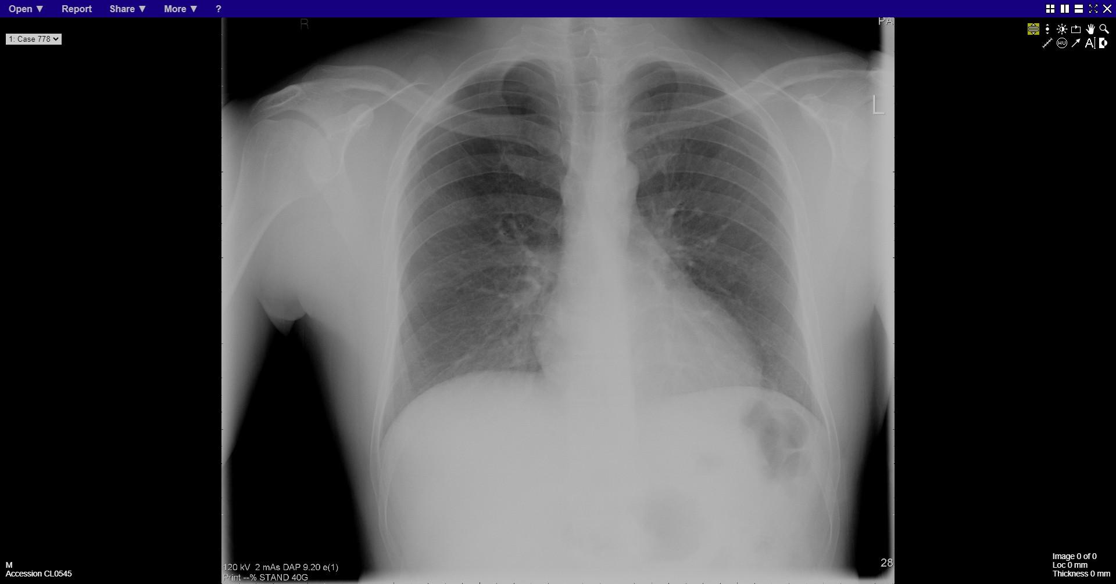
Notes:
Right apical pneumothorax

Slide 29
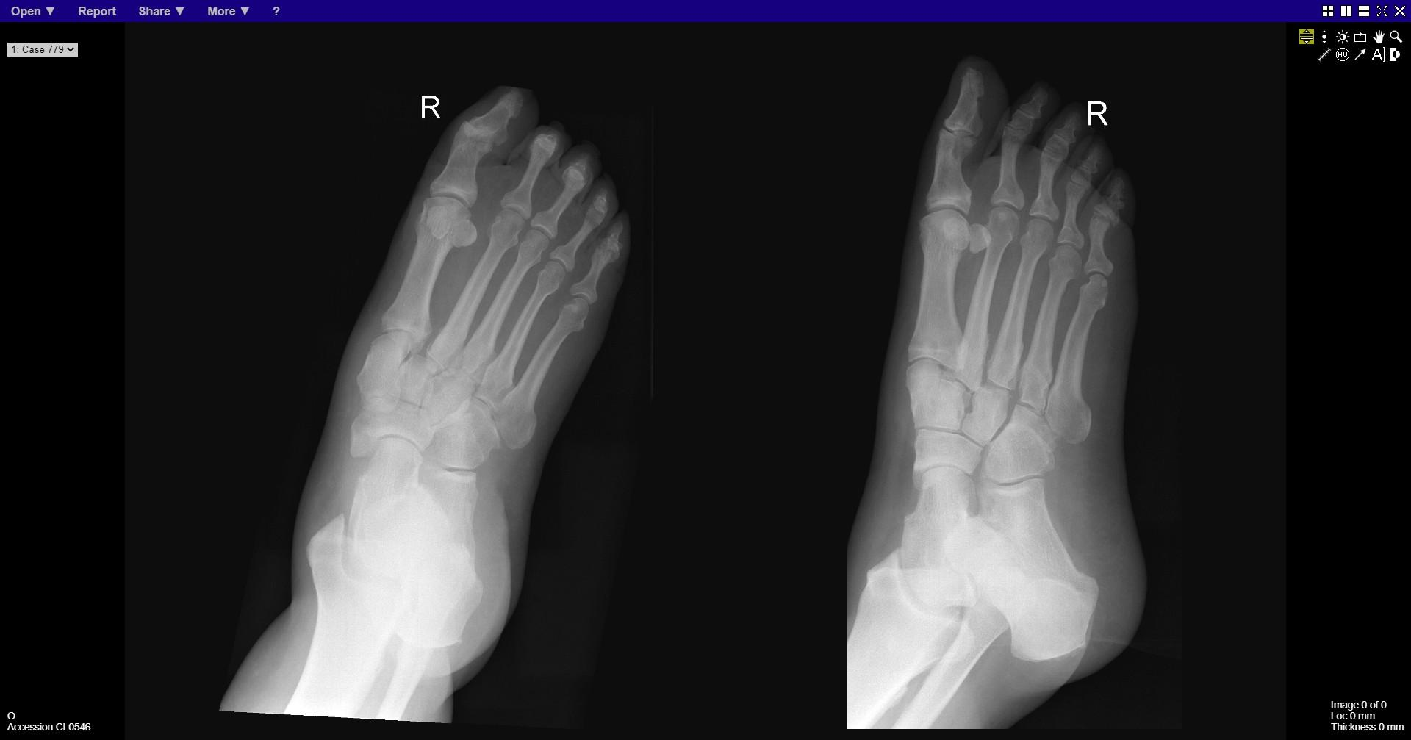
Notes:
Lisfranc injury complex

Slide 30
